Slide 1
Common Core English 9
Please take a syllabus for your class, take out your homework and a sheet of paper.

Slide 2
Warm-Up #2
Locate in your syllabus the bathroom policy.
Make any necessary plans to abide by it starting today.
Label the prompt you would use first, second and third.
*Notice there are only 3 prompts, thus only 3 opportunities to go to the bathroom.

Slide 3
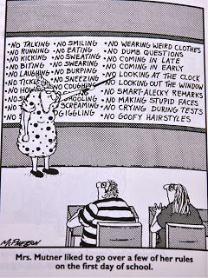
Syllabus Review

Slide 4
CCE9
Due tomorrow:
Parent signed syllabus.
2. Parent engagement activity.
You have a portfolio check the first class meeting of next week.
Be prepared with portfolio and DQ cards.

Slide 5
Exit Slip #1
MLA Heading:
Name
Ms. Haro
CCE9 or CCE10H
04 August 2014
What should I know about you.
What should I know about your academic skills.
What are your academic goals?
What do you do for fun?

Slide 6
Warm Up #2
Create 2 columns, label one FUN and the other NOT FUN. Write at least 3 things in each column that you did this summer.
Share out one of each with your table, introduce yourself.
You will share 1 with the class.

Slide 7
Warm Up #3
Write 3 things that describe you or that you like.
Each of the 3 things MUST have the first letter of your FIRST name.
Ex. K – Kind, talKative, Kaleidscope etc…

Slide 8
Warm Up # 4
Take out the pre-write from last class.
Choose who you want to write about (keep it to one or two people).
Add details that you will use to write your body paragraphs.

Slide 9
Warm Up #5 – Please make sure that are writing in complete sentences and answering the questions with detail.
Why is it important to have a big/extensive vocabulary?
How many words do you think 9th graders SHOULD know?
Do you think you know MORE or LESS than that number?
9 minutes.

Slide 10
Warm Up #6
Independently write to the best of your ability a detailed response to the following:
Define what a friend is.
What are some examples of the types of acts we do for a friend?
Give an example of something you have done for a friend.

Slide 11
Warm UP #7
Leave your things on your chair.
We will be taking your ID pictures.
When you are done, you will wait for me against the walls of the hallway between the gym doors and the first door. DO NOT make me tell you to stay in that area or to not disrupt other classes. If you need to drink water or use the bathroom, you will have to wait.
Coming back to class we will be working on writing a short narrative about friendship:
Describe a time when you or someone showed their true colors (to show you who you really are).

Slide 12
Warm Up #8
A Lexile Levelset score is a numerical score given to you when you take the Lexile Levelset test, a reading comprehension diagnostic.
Today, some of you might take your very first test. This score, whether it is your first or not will be used by the school to determine what grade level you are reading at. You will be given a goal based on your score to reach by the end of the school year.
So, do you like to read? Why or why not?
What are some ways that YOU can improve/practice your reading skills? Especially if you said no to question #1.
And, what do you like to read? Outside of school.
Have you ever taken a Lexile test? (yes or no) Or any other reading test? Which?(Don’t worry if you do not rememeber)

Slide 13
Lexile Levelset Test
Use the handout for COMMON CORE 9 on your table and LOOK for your username and password, write it in your agenda under todays date – August 19.
Get a computer, and open it.
If it asks you to choose, pick a user STUDENT. Password is: titans3.
Check the internet antennae at the top bar, it should say Alliance MASS.
3. Type, Achieve 3000 in the URL (bar where internet addresses go)
4. Log in using the information from #1. Next, choose HARO for your class AND WAIT! We will all start together.
*If you transferred from another teacher’s class, you will not be on the list. Come talk to me for your information.

Slide 14
Quiet & Independent Activity
Using your iPad or laptop, go to:
http://commoncore9.weebly.com
CLICK ON THE LEFT HAND BARS TO OPEN THE MENU ☺
Read the directions for the Of Mice and Men anticipation guide.
Answer on a sheet of paper, the answers will be collected the next class.
Before you leave today, turn in your narrative writing assignment titled, “True Colors” – it should be ½ page or longer. Describe a time when you or someone showed their true colors (to show you who you really are).
If you finish your work early, you may go to other links on the class website. By next week, you should watch and take notes all the OMAM 60Second Recap site.

Slide 15
Warm Up# 9
One of the themes in OMAM (Of Mice and Men) is the "American dream," it has powered the hopes and aspirations of Americans for generations.
It began as a simple, but revolutionary idea: each person has the right to pursue happiness, and the freedom to try for a better life through hard work and effort.
What does the idea of the “American Dream” mean to you? What things, events, or accomplishments do you think will make you happy in your lifetime?
You may write, use bullet points, make a bubble map or draw your thoughts.

Slide 16
Hwk Check and Classwork:
Homework:
1. American Dreams, use your warm-up idea and turn it into something larger. Use the 8.5 x 11 paper to expand your ideas (write, draw or bullet points – OR COMBINE ALL OF THESE).
Check it tomorrow and due on Monday/Tuesday.
2. Watch all the 60 Second Recap videos, #1-10. Take notes.
Classwork:
Finish vocabulary.
Write the word and definition.
Write a sentence:
Write a sentence using the word correctly.
Find a synonym or antonym and write a sentence using one.
Find the Spanish word and write a word in Spanish.
Draw an image related or showing the word or its definition.

Slide 17
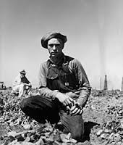
Warm Up # 10 – what can you say about this person. Write ½ page.

Slide 18
Warm Up #11
Write ½ a page in response to the following question:
Should everyone be treated the same regardless of age, sex, intelligence and race? Explain why you think so or not.

Slide 19
Warm Up # 13-14 Weebly

Slide 20
Warm Up #15
Take out your homework:
Vocabulary
Finish reading OMAM Chapter 1 with notes in text.
WARM UP #15 :
What dream do George and Lennie share?
Review the notes format and analysis.

Slide 21
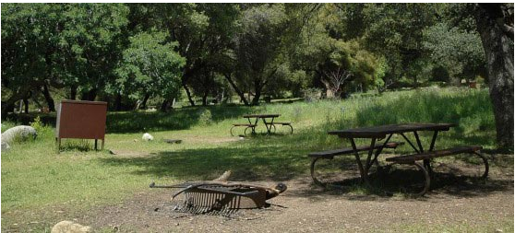
Warm Up #16
Where is your favorite place
outdoors?
Describe this place, what do you like about it, where is it? What memories do you have of going there?
Ms. Haro –
My favorite place in the summer is not the beach, but the Sequoia National Park forest where we stayed at the Potwisha campground. I have many memories of going camping over the years, with my family, friends, and cousins. My favorite spot has to be a giant rock that stood beside a small waterfall surrounded by trees near the Merced River in the Sequoia National Park – I used to get super tired swimming in the cold water, so I would lay on the warm rocks to take a nap. My parents would wake me up and then we would eat, play games and start a fire – we spent our days having fun in the forest every summer.

Slide 22
Grades Explained
Only formative assignments count for the first 5 week progress report card. Because of that the highest grade was a B. To prevent students from having an unrealistic grade of an A. You have not taken a test yet.
For this class, your American Dreams assignment is in the progress report (highest grade 3-B).
After this week, you will be able to see your other assignments.
American Dreams Mindmap (highest grade 3-B)
OMAM Chapter One Vocabulary Sentences
OMAM Chapter One Notes
OMAM Chapter One Test with Vocabulary

Slide 23
Grades Explained
Formative: Use to check students’ progress, to check your progress. Quizzes, exit slips, some homework. “Little”
Summative: Test, Unit test, essay, quizzes. “Big/high points”
Academic: The average of your summative and formative.
Final report card: the average of your summative assignments. No homework, quizzes or other “little stuff”
Life Skills: E-S-U is now a 4-3-2-1 – for the following categories
Participation
Working in Groups
Work Completion
Behavior

Slide 24
Warm Up #18
In the real world, who has power? Is it men or women – does it depend? Give examples and explain your response.
Must do warm up in 6 minutes.

Slide 25
#19 - Weebly

Slide 26
#20
Period 4 and 6 -Today is the FIRST day of Fall, what are some of the things you will miss about the summer or what are some things you enjoy about fall.
Elaborate in complete sentences.
Write 5 minutes.
THEN…take out your homework – chapter 2 work.

Slide 27
Warm Up #21
What is one good thing and one bad thing about being a teenager?

